Slide 1


EMAIL TEMPLATE generation using nlp
Kiran B, tejaswini halmare, Sameer singh, kanchan kachot, Pratikkumar Trivedi, apoorva kharwade

Slide 2
Business objective
To get the nearest email template based on the key input specified by the user
Data(Email Samples) procurement to be done by Web-Scraping based on the user input
Apply the necessary NLP techniques on the scraped data, to generate the template in the respective category

Slide 3
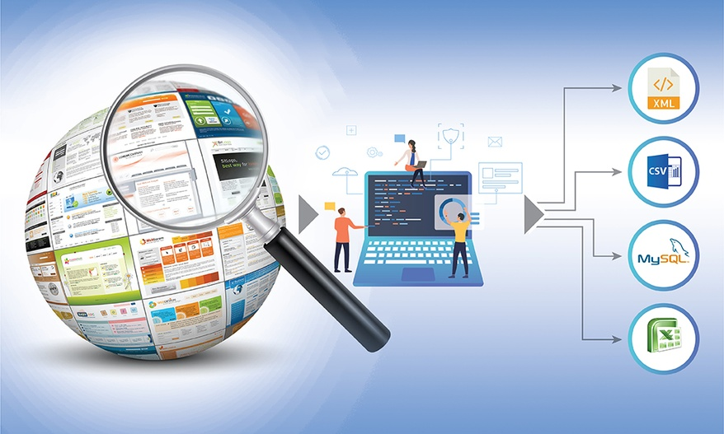
Data procurement
Procurement of the data is done via web-scraping
The web page has to be inspected for its structure before we begin the data extraction
Web-scraped page contains a small section of the relevant data(email sample) and this part can be retrieved using the div_id, classname or CSS selectors

Slide 4
Data pre-processing
The extracted section of the data contains a lot of unwanted information such as html tags and we remove them by using the built-in python function get_text()
Also, certain parts of the extracted section isn’t formatted properly. This is done prior to applying the NLP techniques

Slide 5
Explore & visualize (EDA)
Data visualization plays a quintessential role in obtaining insights from the extracted data and also helps us to make the machine interpret the human language better
Using Natural Language Processing techniques(NLP), we tokenize the data, remove the Stop words, identify the Parts of Speech(POS), visualize the parse tree(dependency tree), Named Entity Recognition(NER), extract the Nouns and Verbs and list their word count(which in turn is provided to the user to select and generate a respective template under the chosen email category)

Slide 6
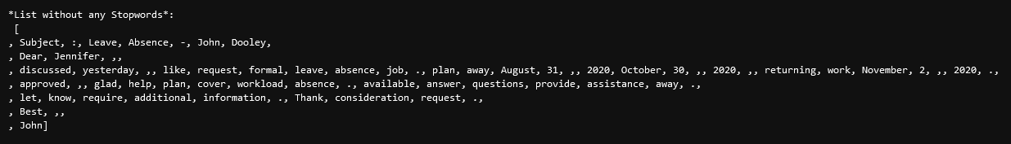
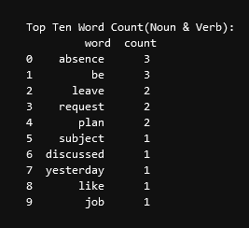
EDA (cont.…)
Tokenization is done to separate each and every word, space and punctuations used in the extracted text. Later the stop words are removed and a list containing the nouns and verbs are generated

Slide 7
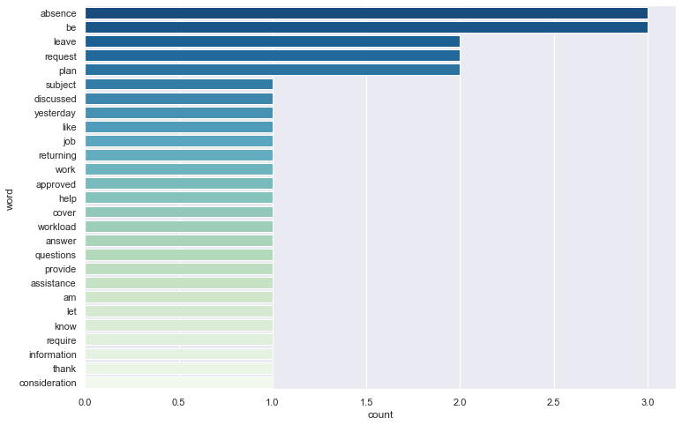
EDA (cont.…)

Slide 8
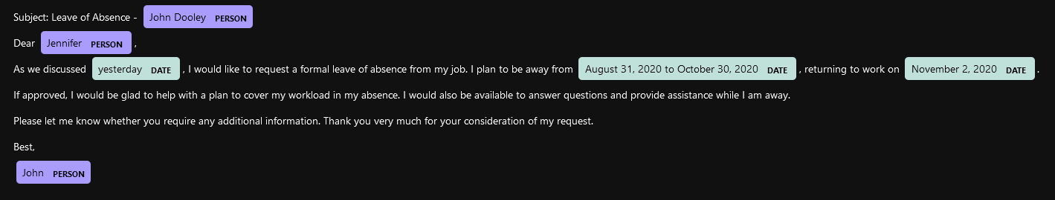
EDA (cont.…)
Named Entity Recognition(NER) is done on the extracted text and visualized as given below

Slide 9
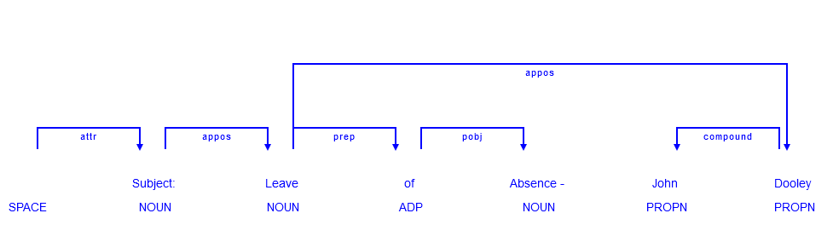
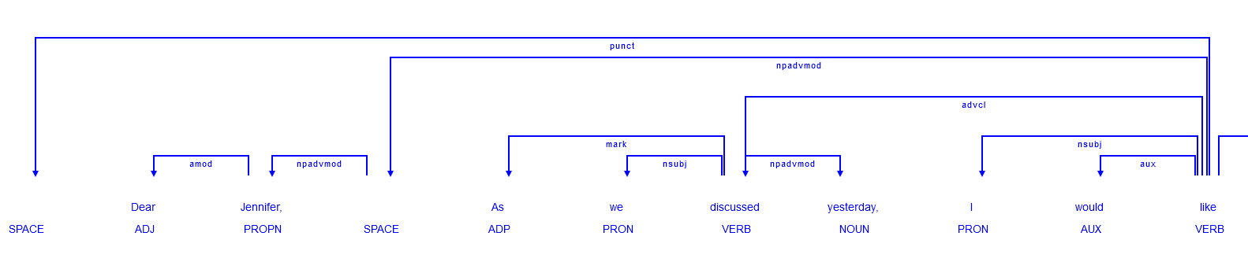
EDA (cont.…)
Dependency Tree or Parse Tree is visualized as given below. This establishes a link on how the tokens are related to each other

Slide 10
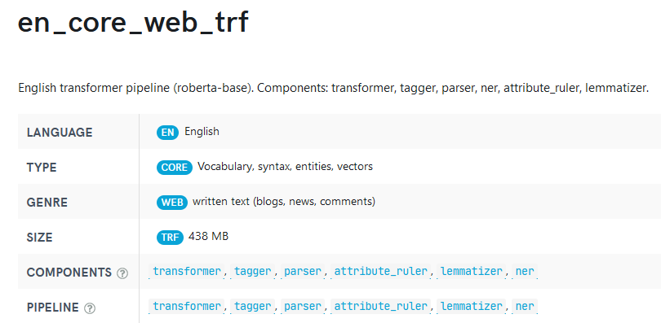

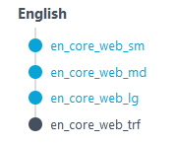
NLP Model
We have used an NLP library called Spacy and utilized the English language model, en_core_web_trf, as it had the highest accuracy evaluation metric when compared to the other English language models available

Slide 11
Pseudocode
#Collect input from user
print(" 1. Vacation Leave Email Template
2. Sick Leave Email Template
3. Birthday Wishes Email Template
4. Cover Letter Email Template
5. Employee work appreciation Email Template
6. Out of Office Email Template
7. Thank you note for Business Email Template")
val = input("Enter your desired category(1-7) for the Email Template:>>> ")
#Based on the user selection, collect input for the respective keyword required
print("Keywords: absence, discussed, vacation, formally, approved, assistance, endeavored, trip")
keyword = str(input("Please enter a keyword from the above list to generate the Template:>>>"))
#Based on the keyword input, retrieve the respective content from the URL, using the div_id or classname
extract = Webscrape_divID(URL1, div_id1)
#Apply Spacy model on the extracted content
nlp = spacy.load('en_core_web_trf')
spacy_text = nlp(extract)

Slide 12
Pseudocode (Cont.…)
#EDA
Word_Frequency(spacy_text) #Lists the count of words
Token_Attributes(spacy_text) #Prints the token attributes such as index, isalpha, is punctuation, is stopword and shape of the token
POS_Attributes(spacy_text) #Lists the attributes of POS tagged words
Macro_Visualize(spacy_text) #Displays Parse tree/Dependency Tree(on the whole text)
POS_Tag(spacy_text) #Displays POS Named Entities from the extracted text
#Generate Template from the extracted text
template = FindnReplace(spacy_text) #Replaces the specific words with the generic ones and formats the text
print("****Here is your Template for the Email category you chose****", template)

Slide 13
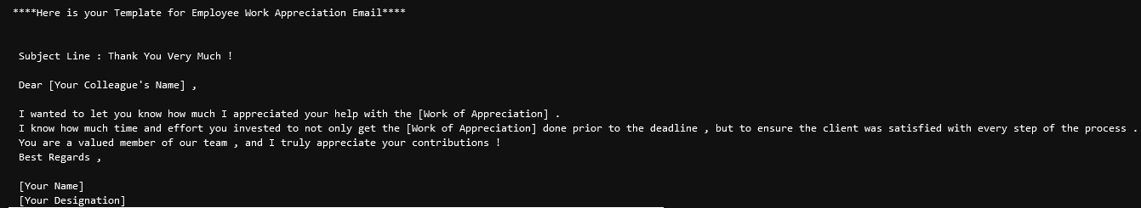
Generated email template(sample)

Slide 14
deployment
Our code was deployed as a web app using the Streamlit tool
We provide a drop down menu to the end user to select their desired Email category
Also we request the user to select a keyword set, to generate the Email template
Based on the user selection, we display the various attributes and visualizations pertaining to the extracted text and finally the Email template is generated.

Slide 15
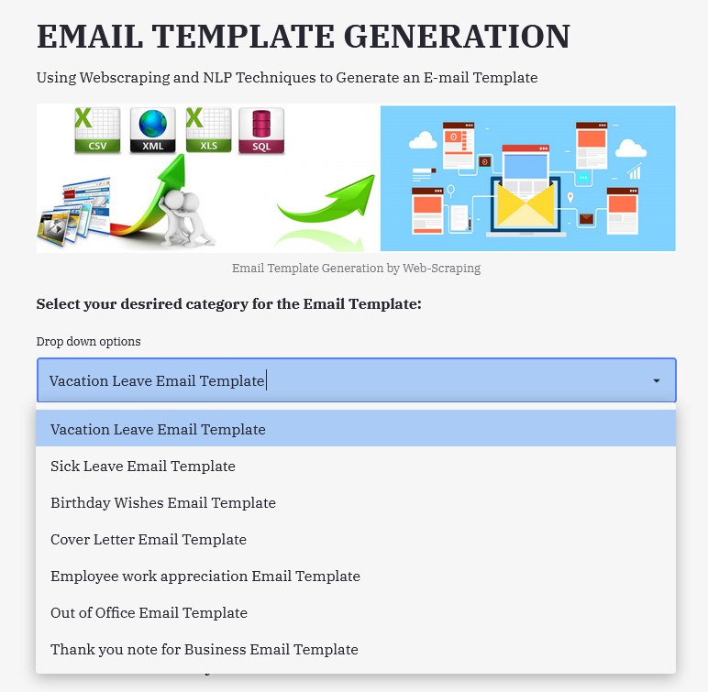

Slide 16
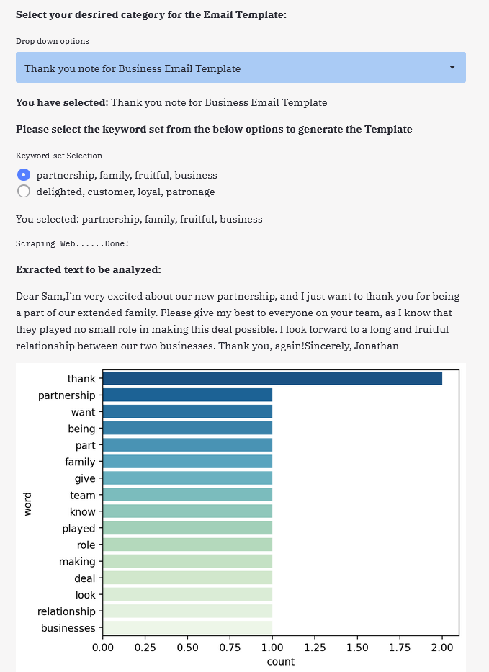

Slide 17
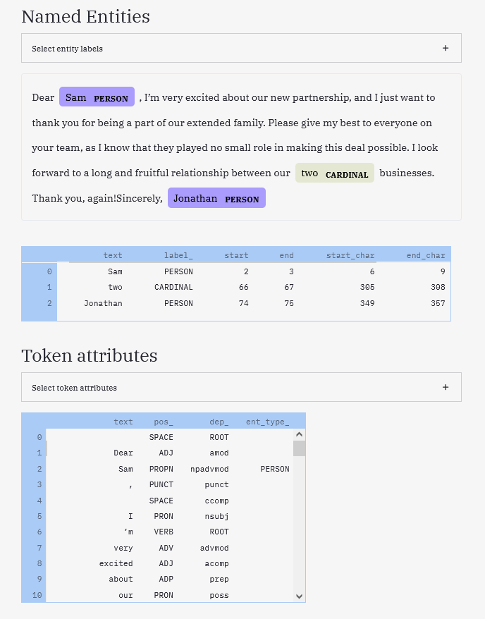

Slide 18
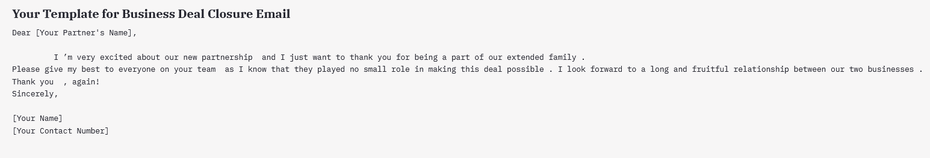

Slide 19
challenges
Below are a couple of challenges we came across
There aren’t enough Email Samples available on the web for different categories. We mainly get the Email Templates. As our project goal was to generate an Email Template from the Email Samples, we could not have considered the Templates directly from the web. Hence we have limited the template generation to two per category
We cannot generalize our algorithm to automatically web scrape every URL and to generate the email template. As each and every webpage is designed differently, manual intervention is required to inspect the webpage and to fetch the data. Also, content formatting has to be done manually as each extracted content uses different formats

Slide 20



